Slide 1


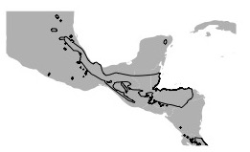




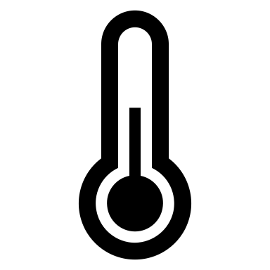
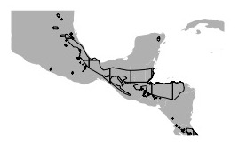
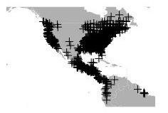
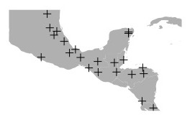
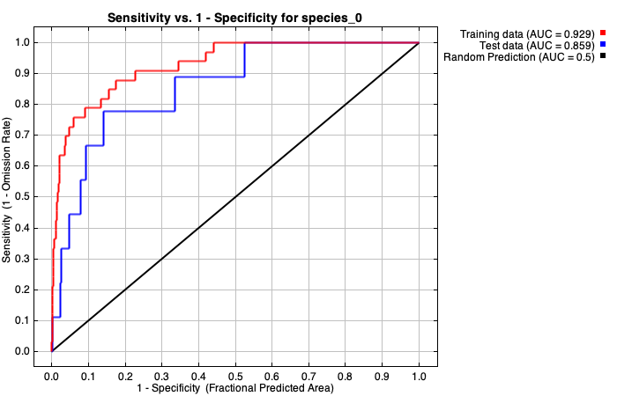

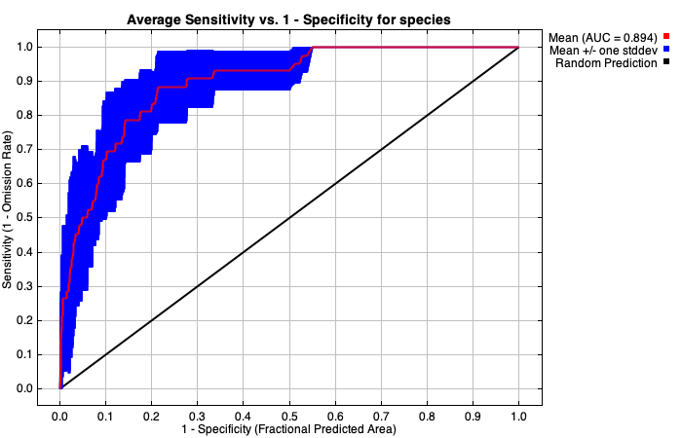
Does climate limit arboreality in
lungless salamanders?
Lauren Mellenthin¹, Erica Baken¹, Dr. Dean Adams¹
¹Iowa State University, Ames, Iowa
Introduction
Arboreality has evolved at least 5 times within Plethodontid salamanders. [1]
Yet no morphological differences separate arboreal and terrestrial species. [1]
There is minimal range overlap between the two microhabitat types. Preliminary results discovered that 71% of the arboreal species distribution does not overlap with the terrestrial species distribution.
From these observations we tested the following hypotheses:
(H1) Terrestrial species do not live in habitats suitable for arboreality
(H2) Arboreal species do not live in habitats suitable for terrestrial life
Materials & Methods
Polygons & Point Data
Climate Variables &
MAXENT Modeling
IUCN or EOO made Polygons
Biologically informed climate variables
Gridded by
2.5 arc-min Resolution
Point data to represent
NA microhabitats
x 5
Centroid point for
each gridded cell
Consensus climatic suitability model
Note: 293 species were used for this study (56 arboreal species, 201 terrestrial species), after excluding European and Asian species.
Conclusions
Despite the broad scale of these climate data, we found:
(H1) Little of the terrestrial species distribution is suitable for arboreality (35%)
(H2) Even less of the arboreal species distribution is suitable for terrestrial life (4%)
Future Directions
These results suggest climate may have influenced the macroevolution of arboreality in this family. Further research is needed to elucidate this pattern.
Understanding the climatic limits of different species can inform future climate projection models. [2]
Figure 1. We used environmental niche models (ENM) to evaluate the overlap in species distributions and their corresponding niche models. Blue coloration representing 0.5 suitability, red coloration representing 0.25-0.49 suitability, and white coloration representing 0-0.24 suitability. Models averaged over 5 all with AUC above 0.85.
Acknowledgments & Literature Cited
Thanks to the following: NSF for funding. Comments & feedback from Dr. Dean Adams’ evolutionary morphology lab, specifically Bryan Juarez and Elizabeth Glynne. IUCN for open access data. R statistical software & packages of dismo, rgdal, and rgeos.
Baken and Adams. Accepted. Macroevolutionary of Arboreality in Salamanders. Ecology and Evolution.
Mcentire, Kd. "Plant Climbing by Salamanders as a Compensatory Behavior in Relation to Climate." Integrative and Comparative Biology. 59 (2019)
Salamander silouettes: Phylopic, Matt Reinbold (modified by T. Michael Keesey), Liscence link: http://creativecommons.org/licenses/by-sa/3.0/
Bonett, R. M., and A. L. Blair. 2017. Evidence for complex life cycle constraints on salamander body form diversification. Proc. Natl. Acad. Sci. 114(37):9936-9941.

